Slide 1

Velocity Engine
Date: 2/06/2009
Presented by: Richard Lewis

Slide 2

Goal
Provide a generalized Monte Carlo framework for pricing financial derivatives
The Framework consists of:
A Path Generation Engine, i.e.:
A vector-based engine that generates uncorrelated random numbers and simulates paths for a given stochastic process.
Razor Pricing Adapter
User-Defined payoff function
Ability to select different stochastic models
Maintenance and reuse of scripts via a template manager
GUI front end as part of the Razor Client

Slide 3
Advantages
Easy to implement new pricing models or modify existing one.
Payoff functions and stochastic processes are defined outside Razor C++ in a scripted language
Scripts are written in a high-level language (subset of Matlab) known by most financial engineers.
For the client, it means :
Shorter time to delivery and easier maintenance
Pricing models can be rapidly prototyped and deployed for variety of option types
Higher flexibility
Clients can modify pricing models and assign them to existing option types in Razor. Therefore, the services of a Razor developer is not needed.

Slide 4
Script Structure
Payoff scripts are saved as templates which can be shared and reused by others
Model scripts are written in an embedded scripting language that is a subset of Matlab
Easy to learn
Platform independent
Extends the MATLAB syntax to make it easier to prototype financial options
It is compiled and linked into Razor dynamically. There is no need to restart Razor.
A typical script includes the following components:
Template name (identifies the type of option)
Imports (controls which random generators and variance reduction techniques are used)
Variables (deterministic and stochastic)
Stochastic process models
Analytical models
A user defined payoff function

Slide 5
Script Structure Example – European Up and Out Call
template EuroBarrierUOCall;
using process::Black;
using random::Sobol;
using distribution::Lognormal;
var S = 100;
var K = 100;
var VOL = .20;
var R = .05;
var T = 1;
var SEED = 2;
var N = 1000000;
[payoff]
function [p]=barrier_payoff(S,K,H)
if (S < H)
p = max(S - K, 0);
else
p = 0;
end
end
Specify the process type,
Random number generator,
and distribution which together defines:
Define variables used to
generate the MC simulation
Payoff of European Up and Out Call

Slide 6
Pricing Adapters
Payoff scripts can be associated with a trade
Trade mapping rules allow overriding static pricing adaptor binding to existing option types
Support both FpmlGenericOption and any option type that has a payoff script associated with the trade as a trade extension:

Slide 7
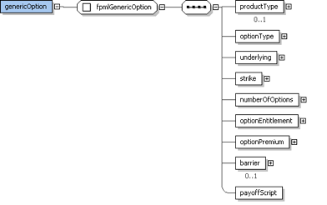
FpML Extensions
The FpML template SimpleOption is extended to:
Accept a new exercise type called “Scripted”.
Add a new attribute “PayoffScript” which refers to the corresponding the scripted template

Slide 8
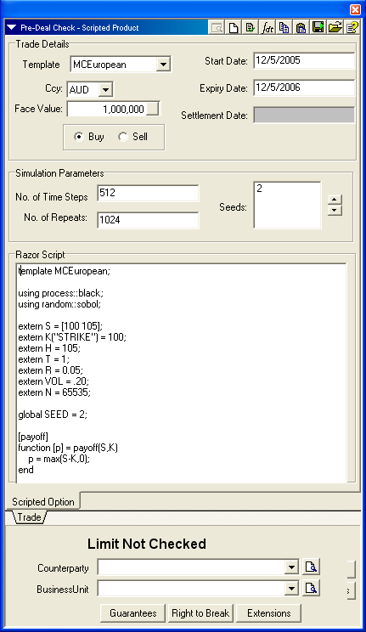
Razor Client Screen
Specify the script template and trade details
Attributes that control path generation including choice and selection of random seeds
Specify the script template and trade details. Define payoff functions and customized stochastic processes

Slide 9
General Design Schematic
Client sends request to price a scripted option trade
Razor pricing adapter forwards request to the Monte Carlo simulation engine
Monte Carlo engine determines if the template script needs to be compiled
Template manager recalls the compiled script from the template cache or compiles it into a DLL
The template compiler generates a DLL from the script code
The template loader loads the DLL into memory
The payoff kernel is dynamically linked to the Monte Carlo Simulation Engine
Paths are generated from either Intel MKL library functions or offloaded onto an nVidia GPU via the CUDA library
Path generation is vectorized and run on either a CPU or GPU

Slide 10
Path Simulation
The following Monte Carlo simulation frameworks are supported in the Razor Velocity Engine
Standard Geometric Brownian Motion 1 and 2 factor without mean reversion (Black-Scholes)
Normal and lognormal mean-reverting processes (Vasicek, Hull & White, CIR etc)
The following Variance-Reduction techniques can be associated with each Stochastic Process Generator
Antithetic Variate
Control Variate
Brownian Bridge
Low Discrepancy Random number generation
Short rate models:
Two-Additive-Factor Gaussian Models
Multi-factor Hull & White
LIBOR Market Models (BGM):
Lognormal Forward-LIBOR model (LFM)
Lognormal Forward-swap model (LSM)
Milstein-Euler approximation
Predictor-Corrector approximation
Complete parametric and non-parameric calibration to caps and/or swaptions

